Slide 1
INVESTMENT CASE STUDY SPARK FUNDS
Group Name:
Prashant Singh
Sushma Subburayan
Rohith Shankar
Swapnila Singh

Slide 2
Spark Funds Investment Abstract
Objectives:
The objective is to identify the best sectors, countries, and a suitable investment type for making investments. The overall strategy is to invest where others are investing, implying that the 'best' sectors and countries are the ones 'where most investors are investing’.
Strategy:
To find the Spark Funds wants to invest where most other investors are investing.
Data Source:
We have real investment data from crunchbase.com,we have three main data tables
Companies.txt
Rounds2.csv
Mapping.csv
Goals of data analysis:
We want to find best investment type ,best countries and best sector to invest based on constraints of Spark Funds
Constraints:
Investment should be between 5 to 15 million USD per round of investment and countries should be English speaking.

Slide 3
Problem solving methodology
Gathering Relevant Data
companies,rounds2-Details of company name ,country ,investment ,funding type are in these table
Mapping, category list and main sectors are listed here
Data Merging,Cleaning,Grouping ,Filtering and Mapping
We are merging companies and and round2 to create master frame that contains data of companies with investment data then cleaning the columns and rows with null values and that are not useful for analysis further ,using this we are finding top 9 countries with maximum total investment amount .We are merging master date frame to mapping to get primary sector of the companies present in master frame. We are then creating three data frames for top 3 English speaking countries respectively based of Spark Funds constraints.
Analysis and Visualizations
Using above data frames we are find Preferred FT based on raised investment amount between 5-15M$ We are finding top 3 English speaking countries that based on total investments as Preferred Countries. Applying above filters ae are finding topmost primary sectors which got investments most number of times.

Slide 4
Analysis
Gathering Data:
Companies and investment details from crunchbase.com are used for this analysis.
Mapping file with details of category list and main sector for that sector is also provided
Data Description:
Data from two tables round 2 and companies table
Permalink-Unique ID
name
homepage_url
category_list
status
country_code
state_code
region
city
founded_at
company permalink-Unique ID
funding_round_permalink
funding_round_type
funding_round_code
funded_at
raised_amount_usd

Slide 5
Analysis
Data Collection: Data gathered from CrunchBase.com in the form of two Structured data files named Companies and Round2(Investment Details). There is one more file given for mapping 8 primary sectors including “Others ” as a sector. Data Observation: There are 10 columns mentioned in Companies data structure and 6 columns in Rounds2 data file. Some key columns like permalink which is the unique id of the company, country_code, category_List are important for further analysis. In round 2 file company_permalink, funding_round_type, raised_amount_usd are essential ones for further analysis.
Cleaning the Data : There are lots of rows and columns are present in the data which is not having any values or values which are inapplicable or abstract for analysis. It is essential to get rid of such values to improve the accuracy of the analysis. Data Cleaning for Companies and Round2: There are total 663700 Observations are present in the Companies file out of which 10 % are duplicate values which removed by using unique function. Similarly in round 2 8.8 % are duplicate values out of 585901 observations. Data Preparation for Master Frame: After getting unique records in both companies and round2 data file, master_frame has been created by merging both the files. This is our primary data source for analysis and it needs some data cleansing and preparation. •There are some columns named 'funding_round_code’, 'founded_at’, 'homepage_url’, 'state_code’, 'region’, 'city’ which are not needed for further analysis ,using drop() function to drop all these columns. • There are rows on which null values are present for ‘raised_amount_usd’, ‘country_code’, ‘category_list’ columns having 17.39%,2.97%,7.55% respectively. Removing these values and taking only values which are not null. There are 89108 observations and 10 columns are present after cleaning and preparing the data.

Slide 6
Analysis
Data Competency and Preparation
Data Preparation for Mapping data : Mapping data contains all sub-categories in category list and other 8 main sectors (e.g. Automotive & Sports Blanks Cleantech / Semiconductors Entertainment Health Manufacturing News, Search and Messaging Others Social, Finance, Analytics, Advertising ). It shows relation between sub category to main category marked as “1” otherwise “0”. For merging with master_frame, it needs to reshape in the form two columns ,so we are using melt() function. There are 6890 observations are present with 689 sub categories. There is one Null row which removed and a blank column. The “Others” is considered as one main category . In master_frame, for getting primary sector of each observation business agreed to take first String before vertical bar “ | ”. for merging mapping data with master frame, a primary sector column is created. After merging master_frame with category_mapping (i.e. created from mapping data ),there are rows which are showing null value in two columns “main_sector” and “category_list” around 7.23% respectively. After dropping these rows master_frame is in better shape for further analysis. After merging there are 88529 and 11 columns are present in the master_frame .

Slide 7
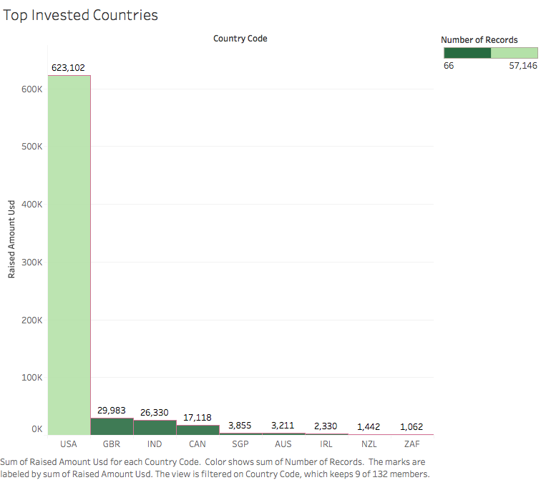
TOP 9 COUNTRIES WITH MAX INVESTMENT

Slide 8
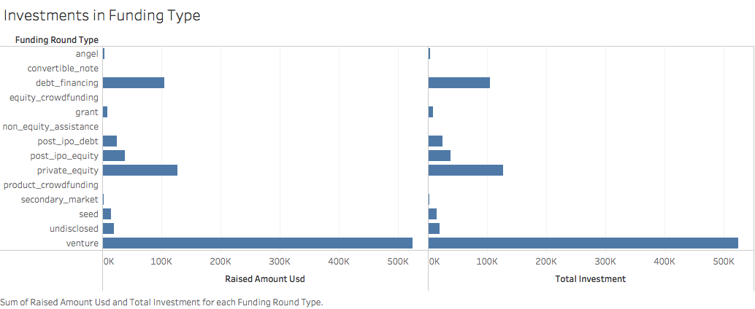

Slide 9
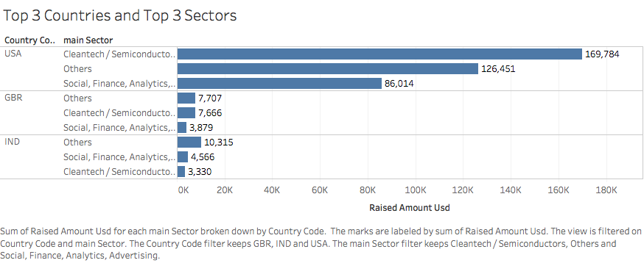
TOP 3 SECTOR IN PREFERRED COUNTRIES

Slide 10
Conclusions
Based on Sectors and Shortlisted countries: •Top three sectors with highest count of investments in USA: Others 2923 Cleantech / Semiconductors 2297 Social, Finance, Analytics, Advertising 1912 •Top three sectors with highest count of investments in GBR: Others 143 Cleantech / Semiconductors 127 Social, Finance, Analytics, Advertising 98 • Top three sectors with highest count of investements in IND Others 109 News Search and Messaging 52 Entertainment 33
•Total amount raised by venture and between 5-15 million doller in USA 99661.524549 •Total amount raised by venture and between 5-15 million doller in GBR 5028.704358 •Total amount raised by venture and between 5-15 million doller in India 2683.5375520000002 •Total count of investments between 5-15 million USD of type venture in USA: 11149 •Total count of investments between 5-15 million USD of type venture in GBR: 577 •Total count of investments between 5-15 million USD of type venture in INDIA: 299
# Companies with maximum investment in 2nd most invested sector in USA Biodesix 75.300000 Tigo Energy 68.739496 # Companies with maximum investment in 2nd most invested sector in GBR EUSA Pharma 35.600000 Horizon Discovery 31.353719 # Companies with maximum investment in 2nd most invested sector in INDIA FirstCry.com 39.0 Myntra 38.0

